Slide 1
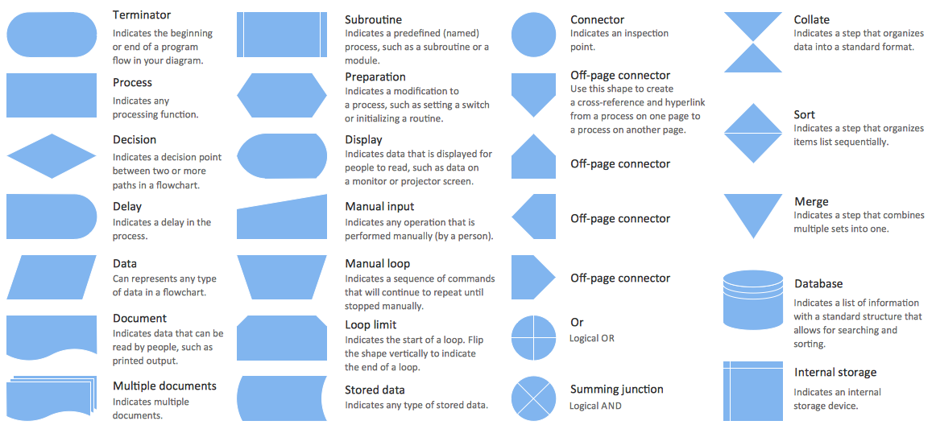

Slide 2
LEGEND:
Terminator
Flow diagram for EV3 software program below:
Process
Data
Decision
Documenting a file
START
Set electrical power of motor to 100%
Delete and open the data file.
Has a period of 1 minute passed?
Yes
No
Measure the Time and the Revolution Per Second
Search the memory browser and save data as a .csv file
An interval of time has passed.
Multiply this value by 60 to get RPM, show it on the EV3 screen and save data as Text.
Save data in file
END

Slide 3





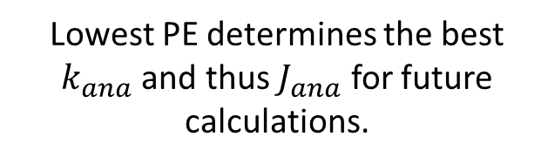


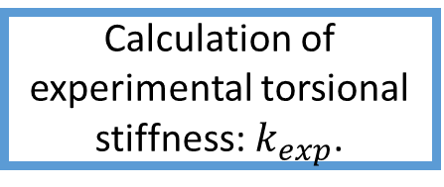
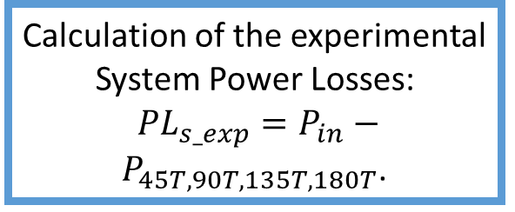
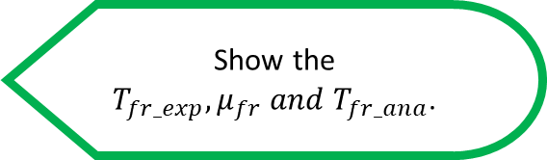
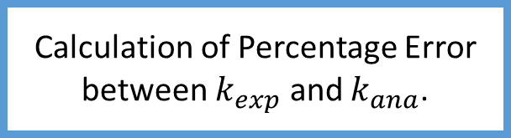
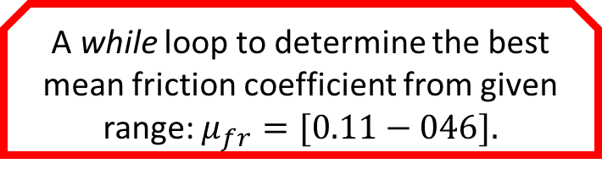
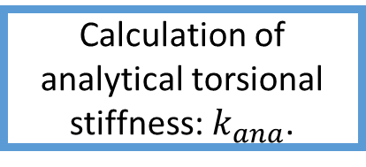
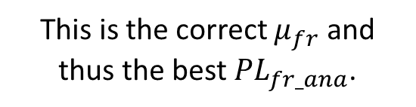
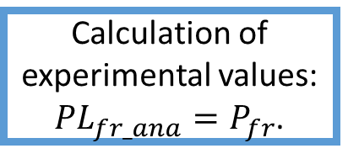

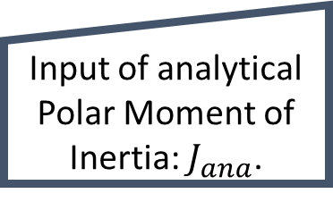



Flow diagram for MATLAB code for power losses below:
LEGEND:
Terminator
Decision
Process
Documenting many files
Data
Display
Loop
Start/End
Preparation
Manual Input
Sub-flow Diagram
POWER LOSSES MODELLING:
RESULTS:
START
START
Friction Power Loss Modelling:
Show the $T_{fr_exp},μ_{fr} and T_{fr_ana}$.
System Power Losses Modelling:
TORSIONAL STIFFNESS CALCULATIONS FOR LEGO SHAFT:
DATA PROCESSING:
Calculation of experimental values: ${PL}_{fr_exp}=P_{in}−P_{0T}$.
START
START
START
Show the $T_{s_exp} and T_{s_ana}$.
Start the 45T experiment data
Delete previous data.
Definition of shaft Dimensions and material properties of ABS plastic: $E, G and ρ$.
Reading RPM data from Lego EV3 experiments into MATLAB
A while loop to determine the best mean friction coefficient from given range: $μ_{fr}=[0.11−046].$
Show the percentage error of ${PL}_{fr} and {PL}_{s}$.
Process the data of this experiment.
Definition of gear geometry dimensions.
Start with: $μ_{fr}$=0.11.
Organize experiment data into time and RPM ($ω_{in})$ cell arrays.
END
Input of torsional stiffness experiment data.
Input of analytical Polar Moment of Inertia: $J_{ana}$.
Calculation of the experimental System Power Losses:
${PL}_{s_exp}=P_{in}−P_{45T,90T,135T,180T}$.
TORSIONAL STIFFNESS CALCULATIONS FOR LEGO SHAFT.
Calculation of experimental values: ${PL}_{fr_ana}=P_{fr}$.
Calculation of experimental torsional stiffness: $k_{exp}$.
Calculation of analytical torsional stiffness: $k_{ana}$.
Calculations of Mechanical Power for each test: 0M, 0T, 45T, 90T, 135T, 180T.
Calculation of analytical induced torque: $T_{s_ana}=k_{eq}φ_{C}$.
Calculation of percentage error between ${PL}_{fr_exp}$ and ${PL}_{fr_ana}$.
DATA PROCESSING.
Comparison of the experimental and analytical Results to pick the best analytical solution:
Plotting of experimental Mechanical Power.
Calculation of analytical
System Power Losses: ${PL}_{s_ana}$.
Is it below 1%?
POWER LOSSES MODELLING.
$$μ_{fr}=μ_{fr}+0.01$$
No
Calculation of Percentage Error between $k_{exp}$ and $k_{ana}$.
END
Calculation of Percentage error between ${PL}_{s_exp}$ and ${PL}_{s_ana}$.
Yes
RESULTS.
Lowest PE determines the best $k_{ana}$ and thus $J_{ana}$ for future calculations.
This is the correct $μ_{fr}$ and thus the best ${PL}_{fr_ana}$.
Repeat for 90T, 135T and 180T experiment data.
END
END
END
END

Slide 4
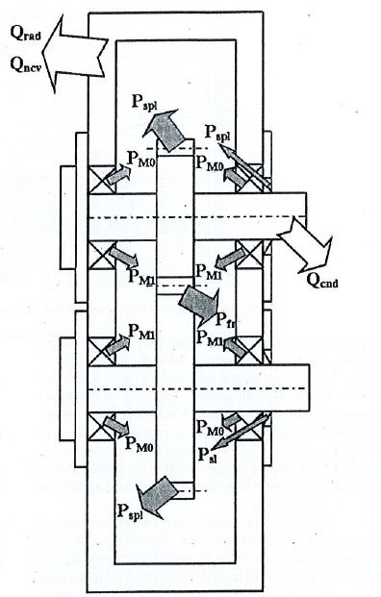


$$≈$$
$${PL}_{fr}$$

Slide 5
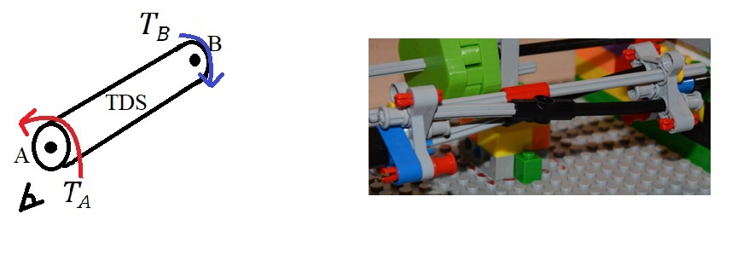

$$≈$$

Slide 6
